Slide 1
CHAPTER THREE
RESEARCH METHODOLOGY
The methodology section is about how the research will be conducted. It covers the following sections:-
3.1 Overview
This section introduces what is contained in chapter three.
ILLUSTRATION
3.1 Overview
This section explains how the research at hand will be conducted. It clarifies the selection and reasons for selection of techniques and tools for doing this research (Campbell, 2016).

Slide 2
3.2 Research design
This is a general plan for conducting research. Also, it is called a research approach or type of research/study.
There are several ways to classify research design:-
Purpose of the study
Exploratory research. It is a study designed to get an insight into a problem that is not well known.
Questions are not structured (open-ended), asked to few people and use words for analysis.
Descriptive research. This study design focuses on the state or status of the issues being researched.
Uses structured (close-ended) questions and descriptive statistics like frequency, percentages, and mean for analysis.

Slide 3
Causal research approach. This design aim at explaining cause-effect relations of events. The design uses structured questions and hypothesis testing to prove cause-effect relationship between variables.
Nature of information: based on the type of information to be collected, we can distinguish:-
Qualitative research. This kind of research mainly gathers non quantified facts (explanations).
It uses open ended questions to collect data in form of explanations.
Quantitative research. This kind of research mainly gathers facts in form of quantities.
It uses close ended questions to obtain data in numerals like percentage.

Slide 4
Mixed research. This kind of research gathers facts in form of quantities as well as explanations.
It uses close both open and close ended questions to obtain data in words and numerals like percentage.
Level of population involvement: research approaches can also be classified depending on the proportion of members of the population in providing data.
Census. All members of population of the study are involved providing data.
Survey. Many members of population of the study are involved in providing research data.
Case study. One or very few members of the population of study are involved in providing research data.

Slide 5
Illustration
3.2 Research design
This study adopted a quantitative research design because its objective is to explain the relationship between internal factors and ICT adoption in SMEs. According to Saunders et al. (2009) explanatory research designs require a large set of quantitative data to test hypothesis on cause-effect relationships between variables that are involved in the study.

Slide 6
3.3 Area of study
This section describes the location where the study was conducted. Moreover, the description should state the reason for selecting the location.
ILLUSTRATION
3.3 Area of study
This study will be conducted at Mwanjelwa market in Mbeya. Mbeya was selected because it has high number of SMEs who have not adopted ICT (Mongo, 2017). Also, Mwanjelwa market hosts the highest number of SMEs among markets in Mbeya.

Slide 7
3.4 Population of study (Unit of analysis)
This section is about identifying the population being studied.
In describing the population, the researcher has to clearly define who is being studied, and specify or estimate their population size (N).
When there are no basis to establish the population size, the research should clearly indicate that the population can not be estimated and provide reasons why it is not possible to estimate such the population.

Slide 8
Illustration
3.4 Population of study
The population of this study cover all the SMEs at Mwanjelwa SIDO market in Mbeya. This market’s administration office record indicate that there about 427 SMEs operating at the market (Personal interview with SIDO market officer, 12 November, 2023).

Slide 9
3.5 Sampling
A sample is a small group of people or items selected to represent the population being researched.
Therefore, sampling plan is determination in advance the sample from a given population before data are collected.
It involves deciding on:-
  who is to be part of the respondents,
  how many respondents should constitute the sample,
  and how will the respondents be chosen
3.5.1 Sampling unit
It is a decision about who are to be part of the respondents?
This choice depend on information needed to answer research questions and achieve research objectives?

Slide 10
For example: to assess the factors influencing adoption of ICT in SMEs, the research can decide the sampling unit to be owners of the SMEs.
3.5.2 Sample size
It is concerned with deciding the number of respondents in the sampling unit.
A lower sample size reduces reliability of results and a higher sample size increases cost un-necessarily.
Sample size can be determined either statistically or non-statistically.

Slide 11
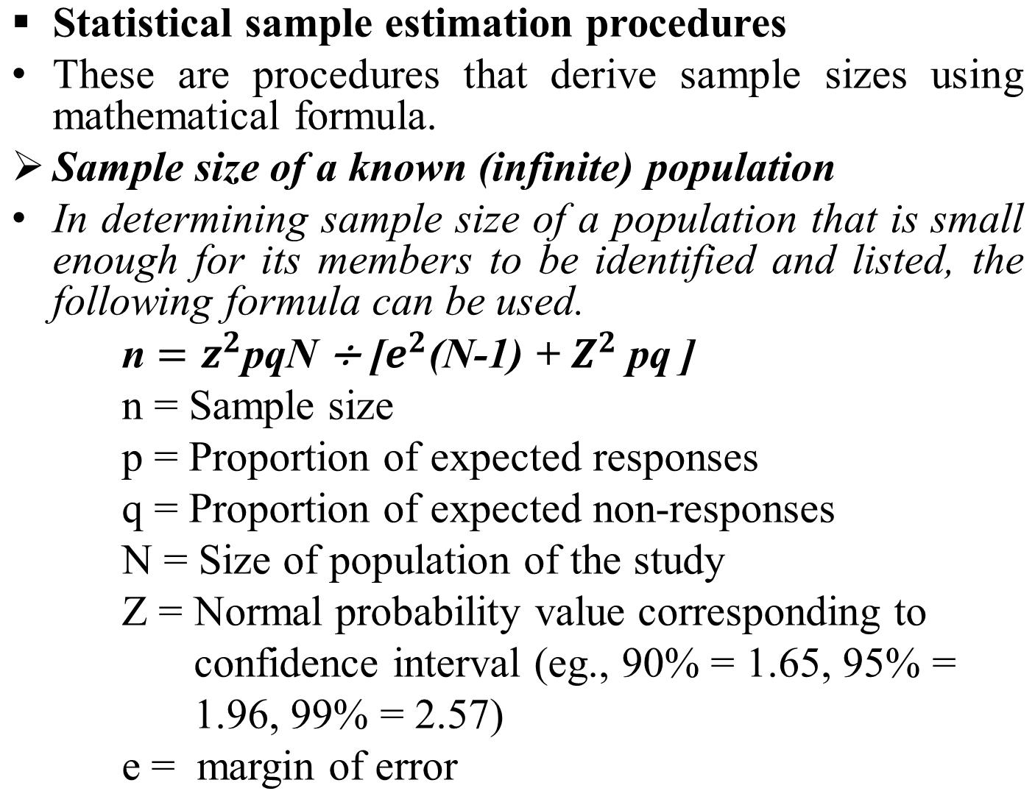

Slide 12
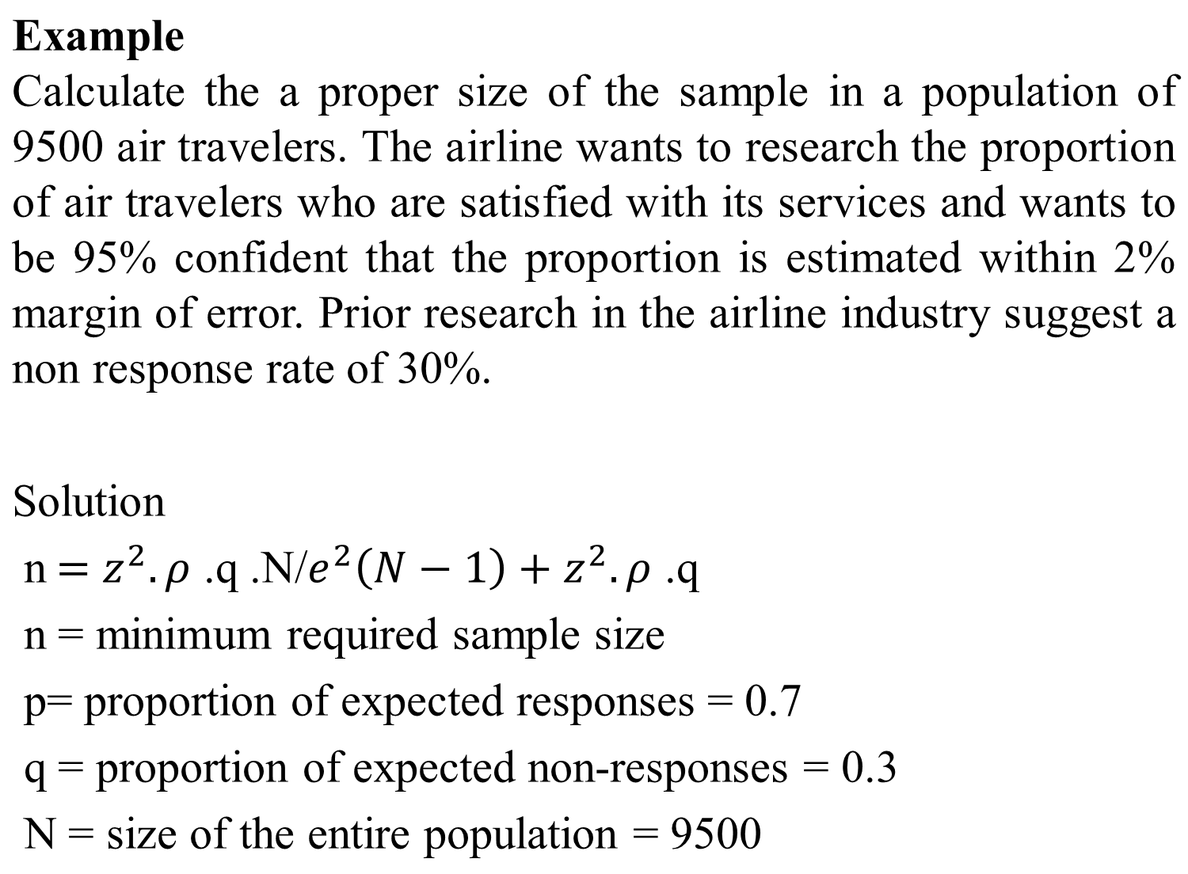

Slide 13
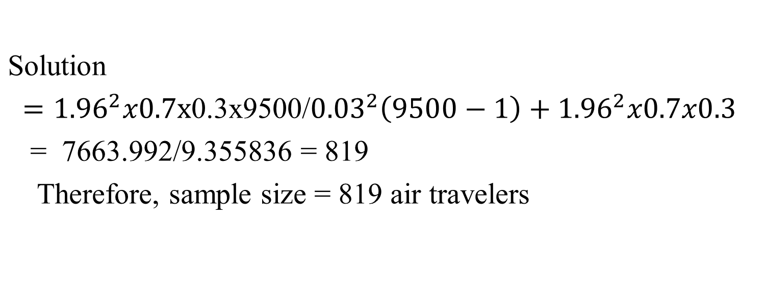

Slide 14
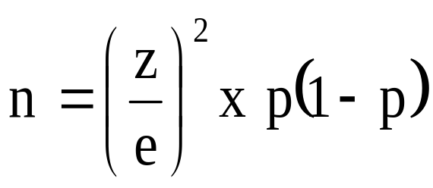
  Formula for infinite population
If 1- p = q (proportion of none responses)
Therefore, n = z²pq
Whereas
n = sample size,
z = normal value of the selected level of confidence,
p = response rate,
e = margin of statistic estimate error allowed.

Slide 15
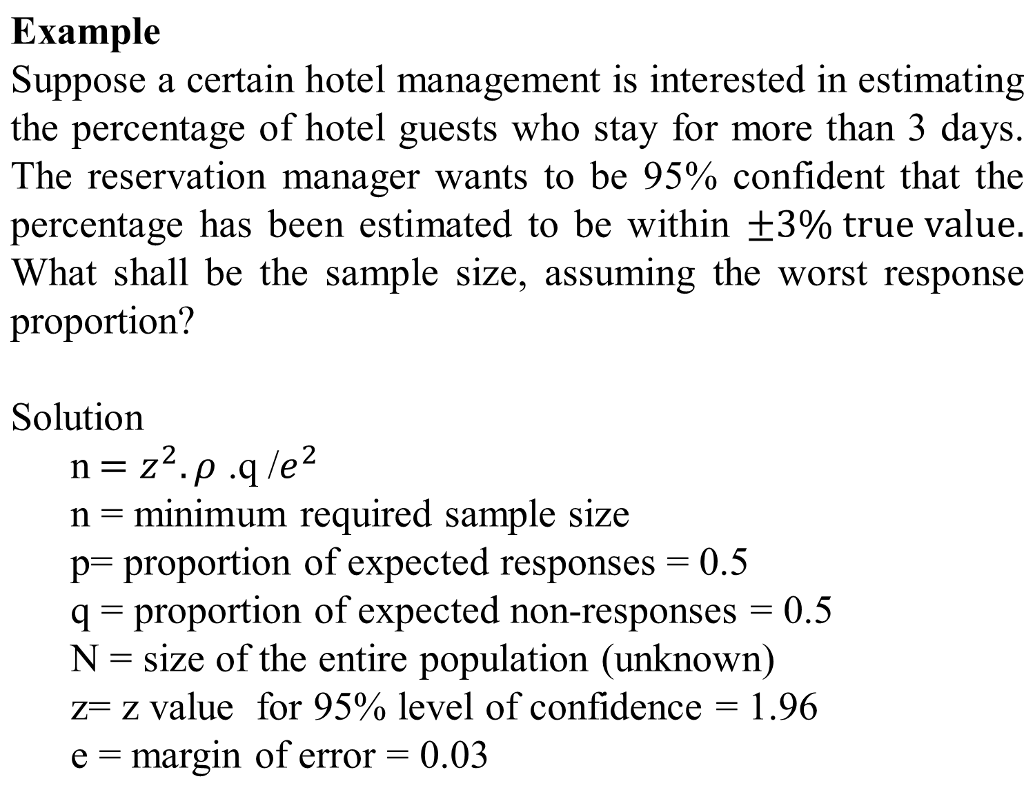

Slide 16
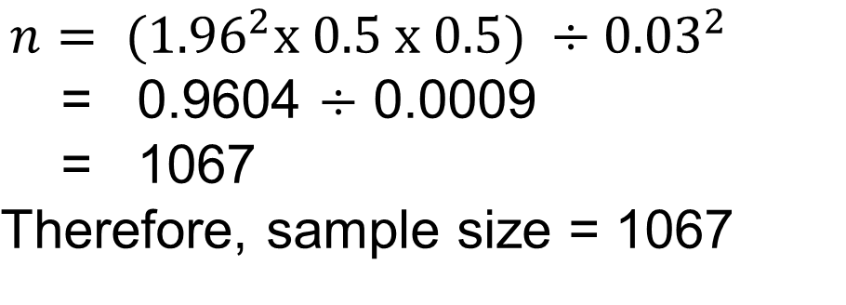
Non-statistical sampling procedure
This procedure involves determining sample size based on the subjective judgments that are properly argued/justified.
The judgement criteria may include expert opinions in previous research, budget constraints, time constraints, availability of respondents, adequacy of required information, and support from credible literature.

Slide 17
Example 1
In this study, 50 owner managers of SMEs will be selected as respondents because they are the only number of SMEs available in the study area. This sample is sufficient because, a minimum sample of 30 respondents is enough to achieve normal distribution (Kothari, 2004).
Example 2
Following Sudman’s suggestion that a sample size of 100 is desired for each group of respondents (Aaker etal., 2002), this study will sample 100 Batiki producing small firms. The researcher can meet this sample size with the available budget and time, and it is suitable because this study is focused on a group of small businesses engaged in Batiki manufacturing only. Budget and time are critical determinants of sample size (Aaker etal., 2002).

Slide 18
3.5.3 Sampling procedures
Deals with methods of selecting the respondents i.e. how should the respondents be chosen?
There are two main sampling procedures or methods.
Probability sampling. This is a way of choosing a sample from a finite population, such that:-
  every person (item) in the population (N) being researched has a known probability/chance (n/N) of being selected as a respondent in a sample of size (n).
  a confidence limit for sampling error can be calculated.
Therefore probability sampling are less biased and require ability to identify all the members of the population.

Slide 19
Common probability sampling ways include:-
Simple random sampling. This method of sample selection that gives every member of the population of study an equal chance of being selected. It removes researchers bias.
For example
To select respondents from customers of a bank who do business, a register of their names can be prepared. The letters of each of the names can prepared, mixed in a bucket and one selected at a time until the sample size is reached.

Slide 20
Systematic random sampling. This is a probability method of selecting samples both randomly and in a pre-determined order.
Randomness is usually introduced by selecting from a list of the items an item to start with, and thereafter decide to select after every certain interval.
For example, if you want to research students studying bachelor of Telecom Eng. on a given problem you can list them alphabetically. Then you can write the name of each student on its own piece of paper and mix the papers in a bowl to select one paper. Starting from the name of the selected paper in the alphabetical list of students you can start choosing every third item until you get the total number of the required sample.

Slide 21
In an evenly distributed homogeneous population, systematic random reduces the possibilities of repeatability or sampling errors.
However incase of repeated fault one can continue choosing a fault sample every interval. For example; if a machine faults on every 20th item of production and the unit from which sample is drawn is 40th item.
Stratified random sample. This sampling method involves subdividing the population being researched into non overlapping subpopulations (strata) and then picking a sample from each stratum e.g. customer of a bank who are small, medium and large business owners.

Slide 22
The strata should consist of homogeneous samples from one stratum and different from another stratum (mutually exclusive groups).
If samples are simply randomly selected from each group/stratum, the procedure is called stratified simple random sampling.
For better results from stratified samples, size of individual samples drawn from each stratum should be proportionate to the size of their representative strata. This is stratified proportionate random sampling.

Slide 23
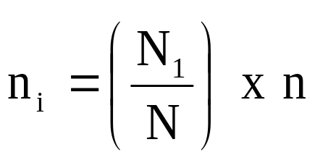
The formula for proportionate simple random sampling is given by
Example 1
A stratified sample of size n = 60 is to be taken from a population of size = 4000 which consists of three strata of size N1 = 2000, N2 = 1200 and N3 = 800. If the allocation is to be proportional, how large a sample must be taken from each stratum

Slide 24
Solution
Substituting in to formula
n1 = (N1/N) * n
We get
n1 = (2000/4000)*60 = 30,
n2 = (1200/400)*60 = 18 and,
n3= (800/4000)*60 = 12
Therefore a sample of 30, 18 and 12 should be selected from the three strata of size 2000, 1200 and 800 respectively.

Slide 25
Non probability sampling procedures. Procedures of obtaining samples in population you can not be able to identify each member and determine sampling error.
Non probability sampling procedures are cheaper and less time consuming, but are biased.
The common non probability sampling procedures include:-
Convenient sampling. This involves selecting the easiest respondents to be accessed by the researcher.
The possibility of being part of the sample is based on lucky and being at the right place on the right time.

Slide 26
Judgment sampling. This involves selecting a sample from members of the population who the researcher thinks are well informed on the marketing issue being researched.
Thus professionals, industry experts or knowledgeable customers are considered better sources of information and so form part of samples.
The activity performed or information one is sought to possess is the major determinant of being included in the sample.

Slide 27
Quota sampling. This procedure involves obtaining a prescribed number of respondents in each of several categories or strata.
Quota sample are used when it is deemed expensive to obtain random samples from strata.
For example
In determining voter’s attitude towards increased tax refunds to elderly persons, an interviewer working in a certain area might be told to interview 5 male self-employed home owners under 30 years of age; and 10 female wage earners in the 50-60 year bracket who live in apartments and 4 retired males over 60 years of age who live in mobile homes.

Slide 28
    Thus in quota sampling, the number of samples in each group is by judgment of the interviewer’s discretion.
    Snow ball. In this method the interviewee identifies one respondent. Others will be identified by asking the respondents on other potential respondents they know.
    This method is better used when there is no knowledge on where to find respondents.
    However, it is subject to respondent’s connection’s bias.

Slide 29
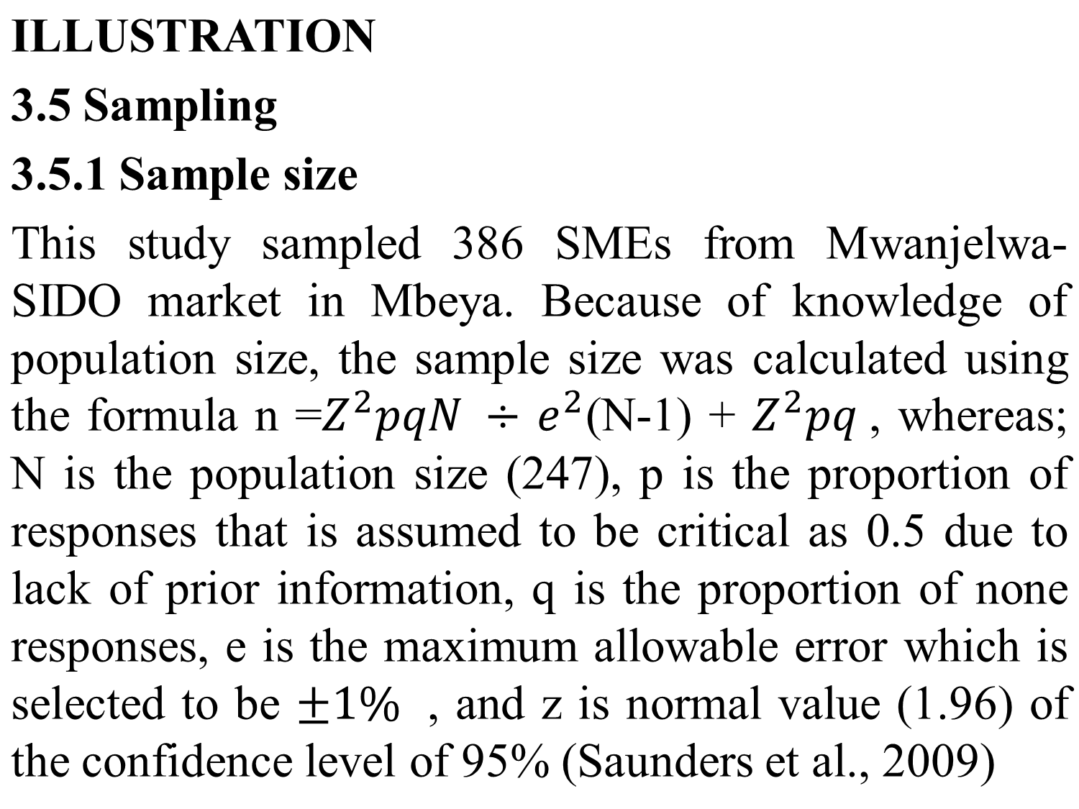

Slide 30
3.5.2 Sampling procedure
This study used simple random sampling in choosing the sample of SMEs. Card boxes, each containing a name of the SME owner was prepared for all 427 SMEs at Mwanjelwa SIDO market in Mbeya. Then one card was drawn blindly and without replacement, each time the cards were mixed in the bowl until all 386 SMEs were selected. Simple random sampling avoid researchers bias in selecting the respondents (Saunders et al., 2009).

Slide 31
    3.6 Data collection methods
    These is the decision about the methods to be used in collecting the required information. It involves specifying the required data, method for collecting the data, and why the method is considered suitable.
    3.6.1 Types of data
    There are two main types of data namely:-
      Secondary data
      Second hand data previously collected for another purpose other than the research problem at hand but may still prove helpful.
      Sources include; business trade associations, archives, periodic census, government records, internet and consulting houses.

Slide 32
      Secondary data are cheap and convenient. However, they have the following problems:-
      Inadequate: in developed countries, there is often no enough secondary data. The culture of storing comprehensive marketing data is not there or too recent ensure enough data.
      Unreliable: available data are often too biased to depend on for decisions. Official data are highly exaggerated to reflect good image while business data are highly under estimated for tax evasion. This calls for knowledge of adjusted reporting.

Slide 33
      Non-comparability: specifically in developing countries data are infrequently collected making them fragmented or outdated for trend analysis.
      In addition, concepts vary across nations. For instance; a small business in Tanzania has less than 50 employees while it has up to 500 in the USA. For this reason cross nation data for the same concept become not comparable.
      Therefore in order to use secondary data, validation (consistency checking) is required.

Slide 34
  Primary data
  Data gathered for the first time and specific for the purpose of solving the research problem at hand.
  Sources of primary data include; sales representatives, owner managers, distributors, customers and industry experts.
  Primary data are the most update and specific ones. However, they are the most cost fully and inconvenient. They have to be collected only if secondary data can not adequately answer the research questions.

Slide 35
  Other problems of primary data are:-
  Lack of proper sample frames. developing countries lack proper telephone directories, census, social and economic characteristics and street maps from which to draw samples.
  This makes probability sampling not effective. Thus creativity in research design is needed.
  Failure to communicate opinions: where products are new, customers often fail to express their opinions because expression of opinions require knowledge about product in question.

Slide 36
  Un-willingness to respond. Strangeness of researchers or research concepts to respondents often results to resistance in providing information.
  This can be for cultural reasons (e.g., in countries where husbands both earn income and dictate use, women can not answer such questions) or fear of giving information for economic reasons (e.g. tax evasion or competition).

Slide 37
  Language and comprehension. Differences in idioms and difficulty of exact translation create problem in getting intended data and in interpreting respondents’ answers.
  For example: A family in U.S.A means parent and children while it means parents, children, grand parents, aunts, cousins and so forth in Latin America. Thus loosely asking a family question in USA with a connotation of Latin America may lead to wrong data.

Slide 38
  Thus it is important for questionnaires to be designed perfectly.
  One of the technique often used in overcoming language barrier in international marketing researches is back translation.
  It involves translating the questionnaire from its original language to another language and then back to its original. This may help identify confusing words and meanings and look for appropriate ones.

Slide 39
  3.6.3 Data collection methods
  There are various methods which researchers choose to use for collecting data. These methods include:-
  Interview methods
  This way involve obtaining data through conversation between respondents and data collection.
  Individual interview: individual conversation between the researcher and the respondent.
  It is non directive if the respondent is free to explore any issue of concern on the topic.
  This is used for qualitative research in order to gain deep explanation for a phenomenon.

Slide 40
  It is semi directive, the respondent is guided to respond on specific issues within a given time systematically. These interviews normally lasts for an hour.
  Focused group interview: it is a two way conversation (questions-answers) b/n the researcher and a group of more than respondents but normally not more than ten.
  This can also be non directive or semi directive/focused.
  Normally used as a follow up interview to clarify conflicting results or issues that require follow up

Slide 41
  Observation methods
  Means of getting data without interrogation between the researcher and the subject.
  It is based on watching the subject’s behaviour directly or in hiding and using instrument like camera and then recording the data of interest. For example, watching how sex workers identify themselves.

Slide 42
Questionnaire method
This method involves presenting a set of questions to the respondent and let him or her answer them without guide from researcher.
It is the best method for collecting quantitative data for survey research or research where there is a need of large number of data to conduct explanatory research or test hypothesis in explanatory research.

Slide 43
Document review method
It involves viewing documents which consists of data collected for another purpose.
This method is suitable for collecting secondary data
3.6.4 Research instruments/tools
Tools which assist researchers in collecting data.
They are used to capture, record or keep data during their collection.
There are two main types of instruments used in data collection which are:-
Notes:
Research Instruments
These are tools that researchers use in collecting data. They are instruments in which facts being gathered are recorded or kept before they can be summarized, analyzed and presented in a more meaningful form.
Marketing researchers have a choice of two main types of instruments that they can use to collect primary data. These are questionnaires and mechanical instruments.
Mechanical Instruments
These are the mechanical tools or devices which records data or behaviours of respondents impersonally.
Usually records respondents actions when the respondent is not aware. Examples of mechanical research instruments include:-

Slide 44
Mechanical instruments: tools or devices which record data about respondents impersonally. Usually they record respondent actions when respondents are not aware.
Some of mechanical instruments include:-
Galvanometer: record strength of subject of interest or emotion aroused.
Eye camera: records eye movement (what are respondents looking and how long).
Audiometer: inserted in TV sets to record when TV is on and to which channels.

Slide 45
Mechanical instruments are suitable for observation methods, experiments and highly technological contexts.
Schedule/questionnaire
A written document or paper in which responses are recorded along questions that are presented to respondents.
When the researcher/moderator presents questions personally to respondents and fills responses in the questionnaire on behalf of respondents, the questionnaire is called a schedule.

Slide 46
3.6.5 Measurements of data and questionnaire
The aim of questions asked in the questionnaire to obtain data/information what measures the properties of interest in a given variable.
Measurement involves the use of numbers to capture variation in data/information about the variable in the questionnaire (pre-coding the questionnaire).
The are four types of measurements which researchers has to consider
Nominal measurement: number assigned to answers for the purpose of identifying options/categories of properties in the variable.
For example, what is your gender
1. Male 2. Female
Although number 2 is greater than 1, it does not mean female has more gender compared to male.

Slide 47
Ordinal measurement: number assigned to answers for the purpose of identifying options/categories of properties as well as indicating the relative amount of properties in the variables.
This measurement is useful for descriptive analysis e.g., frequency, mean, percentages etc.
For example, what is your level of education
1. None 2. Primary 3. Secondary
4. Tertiary 5. Degree or above
The number identifies the types of level of education and indicates which type has more education level compared to another. eg. secondary (3) has more education than primary (2). But, we can not calculate the exact amount of difference in level of education between primary and secondary education.

Slide 48
Scale/interval measurement: number assigned to answers for the purpose of identifying categories of properties as well as indicating the relative amount of properties, and their exact difference in the variables.
This measurement is useful for advanced explanatory analysis e.g., regression analysis.
For example, which one of the following ICT services do you use
1. internet 2. selling online 3. promotion 4. comments
if coding is going to be based on number of ICT services eg. one with internet only = 1, with internet and selling online = 2. Here, we know 2 has more internet services than 1, and the difference is 2-1 = 1.

Slide 49
3.6.6 Types of questionnaire
There are two types of questionnaire namely:-
Closed end questions. Questions which consist of possible answers from which a respondent has to select.
Since they force respondents to choose answers from a given set of options, they are also called forced choice questions.
These questions are used mainly in quantitative research.
For example
In arranging for your trips, do you normally phone ABC airline in person?
Yes No

Slide 50
Open ended questions. Questionnaire that have questions with no options of answers.
Such questionnaires require the respondent to answer them in his/her own words.
These forms of questions are mainly used in qualitative research designs.
For example
What is your opinion about ABC Airlines?
What is the first word that comes into your mind when you hear of the following?
Airline…………………..
ABC Airline……………
Travel……………………

Slide 51
ILLUSTRATION
3. 6 Data collection methods
3.6.1 Types of data
This study used primary and secondary data. The secondary data involved list of SMEs obtained at the SIDO market office responsible for administering operation of the SMEs such as cleanliness, contributions, and bargaining with government authorities. This secondary data was used due to its cheap availability (Kothari, 2010).
Concerning the primary data, the study collected demographic data such as age and ownership of business and gender of owners of business. Moreover, the study collected primary data on its main variables. These variables include extent of ICT adoption, and perception about individual barriers ICT in relation to social norms, behavioral control, and usefulness of ICT. The primary data ensured collected data suits the objectives of this study, and were collected because no prior study has collected suitable data for variables and sample of this study (Saunders et al. 2009).

Slide 52
3.6.2 Data collection methods
3.6.2.1 Documentation method
To collect the data about list of population, the study used documentation method. The documents consisting list of registered SMEs along with the name of their owners and contacts were obtained at the market administration office. The office due to its involvement in administrative services had an update list of the SMEs that in suitable for the study and cheap to obtain and use.
3.6.2.2 Questionnaire method
The study used a close ended questionnaire in collecting primary data. The questionnaire was important in standardizing questions from which to collect a large number of quantitative data for testing relationship between variables. The questionnaire was self-administered to each owner of an SME. This method allowed busy owners to respond at their convenience and avoided the researcher's bias in leading respondents (Saunders et al., 2009). The questionnaire was translated into Swahili because it most managers in Tanzania know the language.

Slide 53
3.7 Research ethics
This is the description of actions not needed in research.
Anonymity of respondents: number assigned to answers to identify types of properties as well as indicating the relative amount of properties, and their exact difference in the variables.
Freedom of participation in research: Respondents are supposed to be free to participate or not participate in research (not be forced).
Authority to collect data: Researcher need authority to collect data. For example, departmental letter allowing to go for data collection. In some kind of data authority is required from authorities such as office of RAS.

Slide 54
  ILLUSTRATION
3.7 Ethical issues
Ethical issues are crucial for accessing data and legitimacy for their use (Saunders et al. 2009). This study considered the following ethical issues:-
3.7.1 Authority to collect data
Before data collection, the researcher obtained letters for approval to collect data from the Mzumbe University as per MUST research guidelines. The researcher showed to the respondents and any respective authority to win their confidence for providing data.
3.7.2 Respondents’ willingness to participate
This study ensured respondents participated in research out of their free-will. The researcher clarified the research purpose to each respondent and expected confidentiality in using data. According to Saunders et al. (2009), respondents have the right to participate and give opinions on their free will, and clarifying research purpose promotes respondent's consent to participate.
3.7.3 Respondents’ anonymity
No name or contact of the respondents have been included in the study to ensure they remain unknown. Research ethics does not allow revealing of respondents (Kothari, 2010).

Slide 55
3.8 Data analysis techniques
These are methods used to process the data into meaningful information.
Two main forms of data analysis techniques:-
Qualitative data analysis techniques: techniques that involve deriving meaning from data that are in the form of explanations or texts.
Addresses issues not well analysed through statistical techniques (how and why, not issues on questions about what or how much).
While there are many qualitative data analysis techniques, the most common is thematic analysis.
  Thematic analysis: A method of selecting from texts keywords which give meaning to the collected data.

Slide 56
3.8 Quantitative data analysis techniques
Techniques used to organize data collected in the form of numbers into meaningful graphs or mathematical expressions that reveal their meaning.
Quantitative data analysis techniques are suitable for answering questions about how much and what. The methods include:-
  Descriptive analysis techniques: techniques that involve expressing data in numbers that only reveal the status of things, such as frequency, mean, percentage, etc.
  The descriptive information can be presented in tables, bar charts, pie charts, etc.

Slide 57
  Inferential analysis techniques: techniques that involve expressing numbers that reveal cause-effect relationships between variables.
  For example, if one wants to answer the question, “What is the effect of internal factors on ICT adoption in SMEs?” It means one wants to know, the amount of effect that each internal factor like capital, experience, and education of owner causes to the adoption of ICT in SMEs. As a result, methods that can calculate the cause-effect relationship between independent variables and dependent variables are needed.
  Although there are many inferential analyses, researchers use mainly regression analysis to understand the effect of one variable on another.

Slide 58
ILLUSTRATION
3.8 Data analysis techniques
This study will analyze the data using descriptive statics mainly percentages and frequencies because its objectives are focused on displaying the level of adoption of technology. According to Saunders et al., (2019) descriptives statistics are suitable for data analysis in studies that intend depict prevailing status on issues being studied. Moreover, the study will use tables, and bar charts to portray the percentages and visually using SPSS. Visual aids such as bar graphs enhance understanding of information (Saunders et al., 2019).

Slide 59
Discussion questions
List the major sections of a research methodology
Discuss the problems of gathering primary and secondary data in research.
Explain the methods of collecting data in research.
If you want to describe the use of ICT among students pursuing diploma in business computing and administration, explain the sampling procedure you are going to use

